Slide 1
Microsoft Fabric Community Conference

Slide 2
Build Multi-Agent Applications in C# or Python Using Azure Cosmos DB
Presented by
Aaysuh Kataria Software Engineer 2
Sandeep Nair Senior Program Manager
James Codella, PhD Principal Product Manager
Architects
Theo Van Kraay Principal Program Manager
Abhishek Gupta Principal Program Manager
Sajeetharan Sinnathurai Principal Program Manager
Mark Brown Principal PM Manager

Slide 3
Introduction
Module 03
Overview of Azure Cosmos DB, agents, and frameworks
Agent specialization
Module 00
Module 04
Setup and deployment
Multi-agent orchestration
Module 01
Module 05
Creating your first agent
Lessons learned, agent futures, Q&A
Module 02
Wrap-up
Connecting agents to memory

Slide 4
Getting started
Github Repository: https://aka.ms/CosmosDB/BankingAgentWorkshop
Azure Subscription with "Owner" rights
Or RBAC permissions to apply RBAC policies
If you do not have this, we will give you a pre-created Azure login.
You will not run Module 0.
You will also need a slightly modified set of workshop instructions.
Laptop with Admin privileges
Need to install and run dependencies in .NET and Python
If you do not have this, use GitHub Codespaces to run this workshop.

Slide 5
Introduction

Slide 6
What is an AI Agent?
“An AI agent is a software entity designed to perform tasks autonomously or semi-autonomously by receiving input, processing information, and taking actions to achieve specific goals.” – Semantic Kernel
“An agent is a system that uses an LLM to decide the control flow of an application” – LangGraph

Slide 7
Why multi-agent?
Multi-agent applications utilize multiple specialized LLMs working collaboratively to address complex tasks.​
Specialized agents can handle distinct tasks leading to more deterministic and accurate outcomes compared to a single, generalist LLM. ​
By assigning specific roles to different LLM agents, such as data retrieval, analysis, tool usage, etc., they can communicate and coordinate to solve problems more effectively and predictably.

Slide 8
Atomic unit of GenAI
Prompt
Input to the model. “Prompt engineering” is the primary lever that customers have to achieve their desired outputs. Developers transform input into prompts that the model can use.
Model
The “AI”. Most apps with use off-the-shelf models hosted as an API. Parameters are turned for desired performance characteristics.
Output
The “Gen”erated output of the model. Typically, we specify the output we want and work backwards to determine the model and prompts we’ll use to achieve it.

Slide 9
Prompt engineering (simplified)
User/App context
Chat history, user data (name, order history, etc.)
Knowledge
AKA “RAG”. Frequently semantic/vector search, but can be as simple as full-text or queries. Can also be enriched with Graph/etc. patterns.
Prompt
“Skills”
Context specific. Often involves “inner” GenAI solutions. For example, NL2Query

Slide 10
Common features of AI Agents
Planning. AI agents can create step-by-step plans and can use feedback to improve refine future outputs.
Memory. Agents rely on short-term memory for immediate prompts and leverage long-term data retention—often via retrieval-augmented generation (RAG)—for broader context and recall.
Perception. AI agents can retrieve data and process information making them more interactive and contextually aware.
Tool Use. Agents can run functions or call external APIs for information or to perform actions. These are also called tools.

Slide 11
AI Agents are a lot like “intelligent” functions
Has inputs & outputs.
Functions take arguments and can (optionally) return something,
AI agents process prompts or data and then generate responses or actions.
Encapsulates logic
Functions contain code that executes a specific task.
AI agents encapsulate reasoning steps and decision-making processes.
Modular & reusable
Both Functions and AI agents can be “called” repeatedly in different parts of an application each time performing their specialized task.
Composable
Both Functions and AI Agents and can be chained or orchestrated with other agents/functions, enabling complex workflows from simpler building blocks.

Slide 12









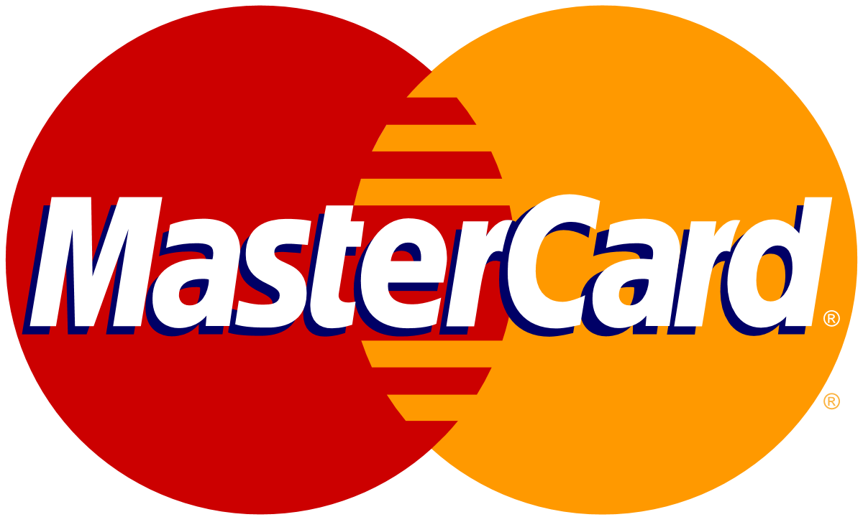



GenAI + Data Use Cases with Azure Cosmos DB
Operational + Vector Database
Retrieval Augmented Generation (RAG)
Conversational History
Semantic Caching
AI Agents
No ETL
Consistent data
Reduce complexity & costs
Personalize LLM on your data
Cheaper than fine tuning
Faster iteration on new data
Conversational context
UX improvements
LLM optimizations
Auditing
Drastically reduces latency
Saves on Token consumption
Reduces costs and latency for LLM
Agent-to-agent transactions
Statefulness
Logging
Notes:
Azure Cosmos DB is Microsoft’s fastest growing database for AI apps.
70% of AI Design Wins include Azure Cosmos DB, and 77% of Cosmos DB’s pipe is build/modernize AI.
Customers use Cosmos DB to combine the operational and vector database – reducing the complexity required to maintain consistency across separate operational and vector databases.
They implement RAG pattern to personalize their LLM responses – and not just chatting with generic documents – but including operational context such as advice based on the customer’s purchase history.
The easiest and most common use-case to sell is chat history – which enables chat experiences to maintain conversational context and to power LLM Ops to know whether prompt engineering improved the quality of GenAI responses.
Conversational history can be extended to power semantic caching to further reduce costs and improve performance of the LLM.
And of course, the most recent trend is AI Agents – where customers use Cosmos DB to power statefulness for agent-to-agent transactions and logging their interactions for LLM Ops.

Slide 13

Retrieval Augmented Generation (RAG)
Enrich LLMs with Context from Operational Data Context
Retrieval augmented generation
Grounding the searches with vector data seamlessly
Support large Knowledge bases for ingestion and retrieval
Semantic caching
Prompt history
1
2
Chunked docs
Embedding model
embeddings
Documents
5
6
9
User
query
Prompt
history
& cache
Vector
search
3
4
“Create a quiz with 10 questions based on xyz data”
User query
Embedding model
Vectorized prompt
7
Prompt + context
Large language model (LLM)
Chat
9
Generated output
Response
8

Slide 14
Announcement slide (dark) with color wipe
Azure Cosmos DB for NoSQL
Serverless or Provisioned Throughput
Instant and dynamic autoscale
Low latency, real-time data transactions
Mission critical reliability (99.999%)
Store data + vectors together, keep consistent
Built-in vector indexing and search w/ DiskANN
Notes:
for MongoDB users, it’s vcore based, and it makes it possible to seamlessly migrate to Azure CosmosDB from existing mongoDB stack without any change of their data schema or query.
This service allows you to provision specific compute sku and storage, and it also supports separate scale up or scale out of your compute resource and storage, which provides better control over resource allocation based on your workload needs.
Additionally, it supports storing both data and vectors together, ensuring data consistency and real-time vector processing combined with ground-truth data, which is essential for GenAI applications that rely on vector search and hybrid search.
Lastly, by using Azure CosmosDB for MongoDB, it naturally brings lots of enterprise features and eco system features provided in Azure, such as HA, geo replica and high reliability, and using Auzre OpenAI to generate Ada embedding in database backend, etc.

Slide 15
Module 00
Deployment and setup

Slide 16
Goals
Begin the deployment of the Azure Services
Learn the structure and get an overview of this workshop
Explore the core principals of multi-agent systems
Complete the configuration of your local environment
Compile and run the starter solution locally

Slide 17
Module 01 Creating your first agent

Slide 18
Module 01 Goals
Learn the basics for Semantic Kernel Agent Framework and LangGraph
Learn how to integrate agent frameworks to Azure OpenAI
Build a simple chat agent

Slide 19
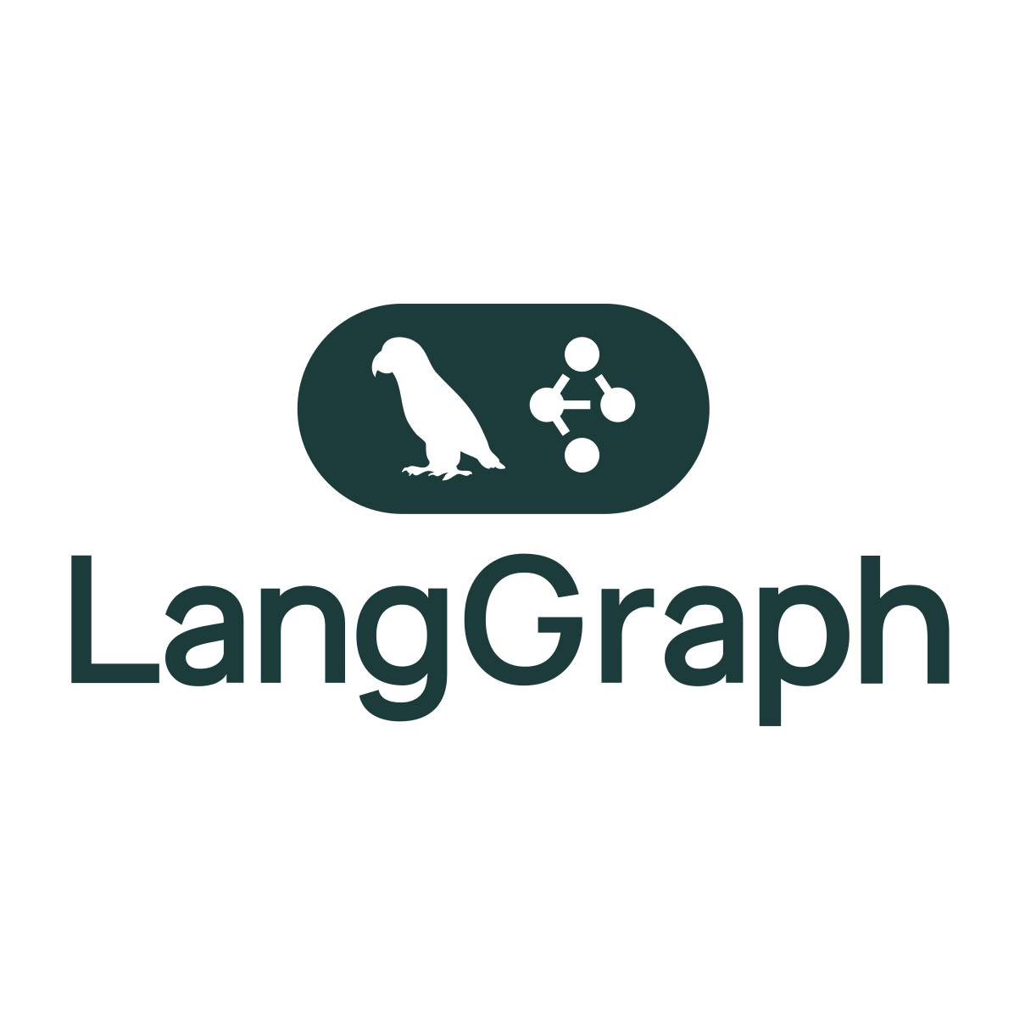
Introduction to LangGraph
An intuitive, open-source framework for building multi-agent AI workflows and orchestrations in Python.
It simplifies the integration of language models, external tools, and APIs, allowing developers to rapidly construct complex AI systems without repetitive coding.
It also facilitates clear state management, agent coordination, and robust control flows to streamline development of scalable AI solutions.
Key features
Agent Routing and Flow Control
Multi-Agent Collaboration
Checkpointing and Memory Management
Integrated Tool Calling
Can leverage LangChain capabilities
Flexible State Management
Time Travel for Debugging and Analysis
Notes:
Nodes do the work. edges tell what to do next

Slide 20
LangGraph - Graphs
Components
Entry point
Example
A node
An edge
Agent node
Action
Action
A conditional edge
Tool
Tool
A tool / function
End node
20
Sources:
https://langchain-ai.github.io/langgraph/concepts/low_level/#graphs
https://learn.deeplearning.ai/courses/ai-agents-in-langgraph
Notes:
Nodes do the work. edges tell what to do next

Slide 21
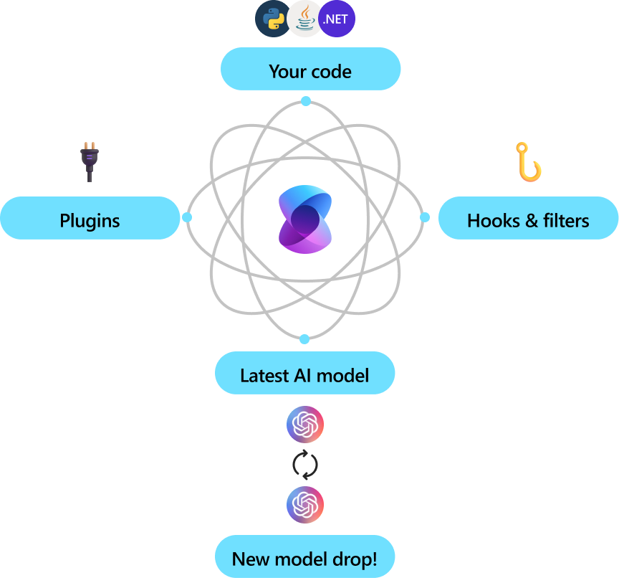
Introduction to Semantic Kernel
A lightweight, open-source development kit that lets you easily build AI agents and integrate the latest AI models into your C#, Python, or Java codebase.
Enables rapid delivery of enterprise-grade solutions by combining prompts with existing APIs to perform actions. Reduces the need for repetitive coding and allows developers to focus on higher-level tasks.
Key features
Orchestration and Flow Control
Multi-Agent Capabilities
Memory Management
Vector Search Connectors
Function Calling

Slide 22
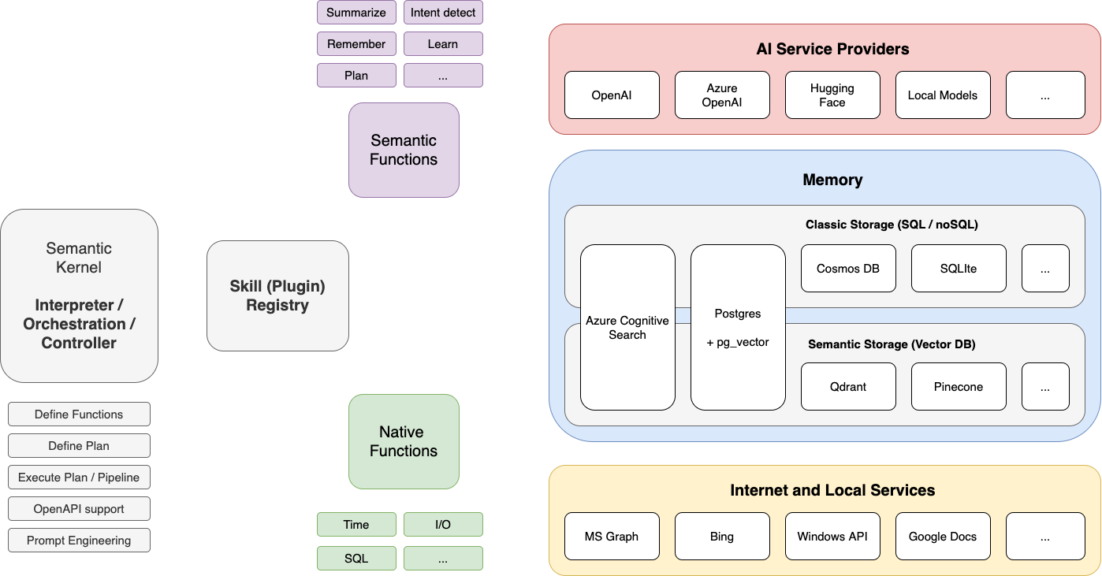
Semantic Kernel - Understanding the Kernel

Slide 23
Two popular agentic architectures
Single-Agent
Router (Supervisor, Planner) Multi-agent
🤖
LLM
🔨
Tool
🤖
LLM
🤖
LLM
🤖
LLM
🤖
LLM
…
🔨
Tool
…
🔨
Tool
🔨
Tool
🔨
Tool
🔨
Tool
Notes:
Why multiple agents?
As you develop these systems, they might grow more complex over time, making them harder to manage and scale. For example, you might run into the following problems:
Over-Tooling Confusion
When an agent has too many tools, it can make inefficient decisions about which tool to call next.
This creates confusion and can lead to suboptimal or redundant steps in the workflow.
Context Overload
As the conversation or task grows more complex, a single agent may struggle to keep track of all relevant details.
Important information can fall through the cracks, negatively affecting performance and outcomes.
Need for Specialized Expertise
Tasks like planning, researching, math calculations, and more each require different skill sets.
A single agent might lack the depth of expertise needed to handle all specialized areas effectively.
Break It Down into Multiple Agents
Consider creating several smaller, independent agents, each responsible for a specific domain or function.
These agents can be as simple as a straightforward prompt and a single LLM call, or as sophisticated as a full-fledged ReAct agent.
By composing these specialized agents into a multi-agent system, you can improve decision-making, maintain clarity on complex contexts, and leverage targeted expertise for better overall performance.
Multi agent scenarios provide multiple benefits
Modularity
Separate agents simplify development, testing, and maintenance.
Specialization
Domain-focused agents boost performance by bringing targeted expertise.
Control
Explicitly manage agent-to-agent communication for greater oversight and stability.

Slide 24
This workshop
User
🧑‍💻
Coordinator Agent
Tool
Transfer to agent
Tools
Tools
Bank transfer
Get offer information
Bank transaction
Create account
Get transaction history
Sales
Agent
Support
Agent
Transactions
Agent
Calculate monthly payment
Bank balance
Tools
Service request
Get branch locations

Slide 25
Module 02
Connecting agents to memory

Slide 26
Module 02 Goals
Learn about agent states, histories, and memory
Learn the basics for Azure Cosmos DB for storing state and chat history
Learn how to integrate agent frameworks to Azure Cosmos DB
Test connectivity to Azure Cosmos DB works

Slide 27
State & Memory
State
A snapshot of your agentic application.
It can contain any information useful to describe the snapshot.
Ideally, it should have enough information such that the application can be restored at a given state.
It can also help maintain consistency and context, enabling agents to perform tasks effectively and coordinate with each other.​
Short -Term Memory
Storage of information within a single session or interaction, allowing agents to maintain context during that session.​
Enables coherent and contextually relevant responses by remembering recent interactions.​
Long-Term Memory
Persistent storage of information across multiple sessions, enabling agents to recall past interactions and user preferences over time.​
Allows agents to learn from feedback, adapt to user preferences, and provide personalized experiences.​
Integrates with external databases to retain information between sessions.

Slide 28
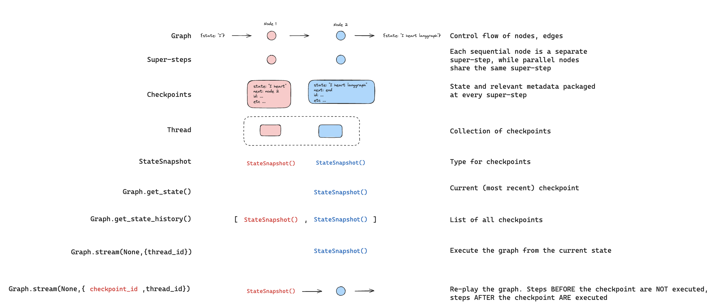
LangGraph – Persistence Glossary
Source: https://langchain-ai.github.io/langgraph/concepts/persistence/

Slide 29
LangGraph - Checkpointers
Easy state management. Capture and store the current state of agents, including the data they're handling, their internal status, and relevant context. This simplifies tracking the progress and condition of your agents.
Reliable persistence. Save states securely to durable storage (like databases or file systems). This means your application can easily recover its previous state after restarts or system crashes, minimizing downtime and ensuring reliability.
Effortless restoration. Restore agents to previously saved checkpoints. This feature allows applications to resume smoothly from specific, stable points without reprocessing earlier steps.
Consistency across agents. In distributed or multi-agent systems, checkpointers ensure consistent states by coordinating checkpoints across different agents, even when they operate in separate nodes or environments.
Customizable configuration. Developers can control how often and under what conditions checkpoints are created. This flexibility helps balance performance and reliability based on specific needs.
Built-in memory. Enable agents to "remember" past interactions, essential for ongoing conversations or repetitive tasks. This persistent memory maintains context across multiple interactions, enhancing user experience and interaction continuity.
Time travel & debugging. Allowing developers to replay past executions to review, debug, or analyze specific interactions. Additionally, developers can fork the graph state at any checkpoint, exploring alternative scenarios or debugging different pathways.
Azure Cosmos DB Checkpointer: https://github.com/shengbo-ma/langgraph-checkpoint-cosmos

Slide 30
Semantic Kernel – Memory & Storage
Checkpointing feature
Simplifies managing dialogue history in advanced conversational applications.
Intelligently truncates or summarizes past interactions.
Designed to capture and store the current state of agents, including the data they're handling, their internal status, and relevant context.
However, in multi-agent chat scenarios, the complexity and dynamic nature of interactions make it challenging to implement checkpointing effectively.
Creating a chat history object
Semantic Kernel uses a chat history object to maintain a record of messages in a chat session.
Enriching histories & messages
You can add messages manually by creating new ChatMessage objects.
This allows you to provide additional information, like names and images, enhancing the richness of the chat history.
Serialization and storage
It's recommended to serialize the chat history and store it in Azure Cosmos DB.
This ensures that the chat history is preserved and can be retrieved later for use in your application.
---
Feel free to adjust these points based on your audience and the specific focus of your session. If you need any more details or have other questions, let me know!

Slide 31
Module 03 Agent specialization

Slide 32
Module 03 Goals
Learn the basics for Semantic Kernel Agent Framework Functions and LangGraph Tools
Learn how to implement semantic and natural language features using vector indexing and search integration from Azure Cosmos DB.
Learn how to define tasks and communication protocols for seamless collaboration.

Slide 33
LangGraph - Tools
Tools are an easy way to associate Python functions with a schema defining the functions name, description, and arguments.
These can be invoked by a model, and outputs can be fed back into the model.
Some outputs can be “artifacts”, or objects that can’t be directly passed to a model but need to be passed to downstream tasks.
Tips
Design tools with clear naming, documentation, proper type hints to facilitate ease of use by models.
Develop simple or narrowly scoped tools to ensure accurate and efficient model utilization.​
Example code:
from langchain_core.tools import tool
@tool
def multiply(a: int, b: int) -> int:
"""Multiply two numbers.""“
return a * b

Slide 34
Semantic Kernel – Function Calling
Example code:
[Kernel Function("GetLoggedInUser")]
[Description("Get the current logged-in BankUser")]
public async Task<BankUser> GetLoggedInUser(){
return await _bankService.GetUserAsync(_tenantId, _userId);}
Automatic function calling
Simplifies the process by automatically describing functions and their parameters to the model.
Handles communication between the model and your code.
Function choice behavior
Represented by three static methods: Auto, Manual, and Hybrid.
Allows the AI model to choose from zero or more functions for invocation.
Integration with plugins
Orchestrates interaction between the AI model and external APIs.
Enables creation of plugins that the AI model can call at the appropriate moment.
Incorporates the best parts of existing function-calling capabilities.
Improves on ease of use, making it more extensible and reusable.

Slide 35
Knowledge retrieval using Semantic Search in Azure Cosmos DB

Slide 36


Microsoft DiskANN in Azure Cosmos DB
Cost-effective, low latency vector search at any scale
Vector compression
Storage and graph construction
Algorithms
Large Vectors
{ D1, D2, D3, D4, D5, …, D99, D100 }
RAM
Compressed vectors
Quantization
SSD
Compressed Vectors
{ D1, D2 .., D10 }
Full vectors + graph
Unlimited scale
Low latency
Robust to data changes
Serverless
Read the whitepaper: aka.ms/DiskANNCosmosDBWhitePaper
Notes:
OWNER: KIRILL
Contrast with Mongo, AWS, GCP (Scann) Talking points:
Powers Bing and M365 copilots
Unlimited scale: indexes with up to 400B vectors, trillions data points
Low latency, single-digit ms
Robust to data changes, highest recall per TPS, e.g. >90% recall at million TPS
Serverless and multi-tenant friendly, demands >60x less memory than HNSW
Vector and Hybrid search (w/Full Text search and re-ranking) on operational data on top of same inverted index
LangChain and Ecosystem Integration

Slide 37
Vector Search in Azure Cosmos DB
Define a container vector policy
{
"vectorEmbeddings": [
{
"path":"/vector1",
"dataType":"float32",
"distanceFunction":"cosine",
"dimensions":1536
}
]
}
Execute a vector search query
SELECT TOP 10 c.title, VectorDistance(c.vector1, {queryVector) AS SimilarityScore
FROM c
ORDER BY VectorDistance(c.vector1, {queryVector})
Define a vector indexing policy
"vectorIndexes": [
{
"path": "/vector1",
"type": "diskANN"
}
]

Slide 38
Full Text Search in Azure Cosmos DB
Container Full Text Policy
{
"defaultLanguage": "en-US",
"fullTextPaths": [
{
"path": "/text1",
"language": "en-US"
},
{
"path": "/text2",
"language": "en-US"
}
]
}
Query with FullTextContains
SELECT TOP 10 *
FROM c
WHERE FullTextContains(c.text, “loan")
Query with FullTextContainsAll/Any
SELECT TOP 10 *
FROM c
WHERE FullTextContainsAll(c.text, "red", "bicycle")
Ful Text Indexing Policy
"fullTextIndexes": [
{
"path": "/text1"
},
{
"path": "/text2"
}
]
Query with FullTextScore (BM25)
SELECT TOP 10 *
FROM c
ORDER BY RANK FullTextScore(c.text, ["bicycle", "mountain"])

Slide 39
Hybrid Search for improved search relevancy
Reciprocal Rank Fusion (RRF)
Vector Similarity Score
Full Text Scoring (BM25)
More Relevant Search Results
+
=
Example Query
SELECT TOP 10 *
FROM c
ORDER BY RANK RRF(FullTextScore(c.text,[‘keyword1’,’keyword2’]), VectorDistance(c.vector, @vector))
Notes:
Store data and vectors together
Keep your data and vectors consistent and in-sync
Simplified architecture using a unified database for both vectors and data.
Vector Search + Query Filters
Find the most relevant documents
Leverage rich NoSQL query syntax
Flat index
100% accuracy
Ideal for multi-tenant scenarios
Quantize vectors for improved performance

Slide 40
Module 04
Multi-agent orchestration

Slide 41
Module 04 Goals
Learn how to write prompts for agents
Define agent routing
Learn how to test and debug agents, monitoring
Learn how to define API contracts for a multi-agent system

Slide 42
Prompts – Instructions for your agents
Prompts serve as a set of instructions or inputs provided to guide an agent's behavior. It helps the agent understand the context, determine appropriate actions (tool calling, passing to other agents) and generate relevant outputs related to the agent’s purpose.
Define agent roles. Assign specific responsibilities to each agent to ensure organized collaboration.​
Give contextual instructions. Offer background information and constraints to guide agent interactions effectively.​
Interaction protocols. Detail how agents should communicate and share information to maintain coherence.​
Set clear objectives. Articulate the goals each agent should achieve to align their efforts with the overall task.​
Provide examples. Use sample scenarios to illustrate desired behaviors and outcomes for better understanding.​
Anticipate edge cases. Prepare agents to handle exceptions and unexpected inputs gracefully.​
Iterate and test. Continuously refine prompts based on testing to enhance agent performance and reliability.
You are a banking transactions agent that can handle account balance enquiries and bank transfers.
If the user wants to make a deposit or withdrawal or transfer, ask for the amount and the account number which they want to transfer from and to.
Then call 'bank_transfer' tool with toAccount, fromAccount, and amount values.
Make sure you confirm the transaction details with the user before calling the 'bank_transfer' tool then call 'bank_transfer' tool with these values.
If the user wants to know transaction history, ask for the start and end date, and call 'get_transaction_history' tool with these values.
If the user needs general help, transfer to 'customer_support' for help.
You MUST respond with the repayment amounts before transferring to another agent.
Example: Transactions Agent Prompt

Slide 43
Routing
Start
Routing directs the flow of information and control between agents in a workflow, ensuring each agent receives appropriate inputs for cohesive system operation.​
It facilitates task division among specialized agents in multi-agent systems for efficient collaboration.
Define functions to determine the next agent based on the current state or input.​
Use these functions to establish edges between nodes (agents) in the workflow graph.​
Agent “A”
Action 1
Action 2
Action 3
Tool
Agent “B”

Slide 44
Testing in Multi Agent Applications
Thorough testing is key to ensuring LLM agents function accurately, safely, and cooperatively across various tasks. Core testing methodologies include:
Prompt Evaluation Use automated tools or LLM-as-a-judge to assess agent outputs for:
Correctness (via semantic similarity to reference answers)
Helpfulness and Relevance (based on how well the response addresses the query)
Frameworks like LangSmith or Ragas streamline prompt-based evaluation.
Multi-Agent Evaluation Types
Final Response: Evaluate the agent’s end result.
Single Step: Assess decisions like tool selection or intermediate reasoning.
Trajectory: Check if the agent followed the intended path to reach the output.
RAG Evaluation Leverage another LLM to evaluate RAG output quality, focusing on:
Faithfulness: Is the answer grounded in retrieved documents?
Helpfulness: Does it address the user query meaningfully?
Correctness: Compare against a reference answer if available.

Slide 45
Monitoring in Multi Agent Applications
Monitoring is essential to ensure multi-agent systems are functioning as intended, remain cost-efficient, and deliver reliable user experiences. Key aspects include:
Observability. Implement structured logging and tracing to capture agent decisions, state transitions, tool calls, and inter-agent communication flows. This helps diagnose issues, analyze behavior, and improve coordination logic.
Metrics tracking. Track key performance indicators such as response latency, token usage, agent invocation counts, error rates, and success/failure rates of tasks. Use dashboards and alerts to identify bottlenecks or abnormal behavior in real time.
Continuous monitoring enables rapid debugging, optimization, and trust in complex agent-based systems.

Slide 46
Responsible AI Evaluation & Testing
Ensuring LLM multi-agent and RAG applications behave ethically, safely, and fairly requires robust and responsible evaluation across multiple dimensions:
Harm & safety checks
Detect and prevent toxic, unsafe, or harmful outputs using adversarial prompts.
Use LLM-as-a-judge, red-teaming, and safety classifiers to flag risky behavior.
Bias & fairness audits
Test with diverse prompts and personas to uncover demographic or cultural bias.
Evaluate for response consistency and neutrality across agents.
Transparency & explainability
Trace and log agent reasoning, decision paths, and tool usage.
Enable reproducibility for debugging and accountability.
Ethical & policy alignment
Validate agents respect sensitive boundaries (e.g., legal, medical, financial).
Ensure responses align with organizational values and responsible use guidelines.
Tools & techniques
Apply LLM-as-judge, adversarial testing, safety filters, and feedback loops.
Monitor both individual agents and multi-agent coordination patterns.

Slide 47
Module 05 Lessons learned, Q&A

Slide 48
Tips & Lessons learned
Use an AI Framework for agent, service, and tool orchestration Frameworks like LangGraph or Semantic Kernel can simplify the coordination, communication, and workflow management in apps that have multiple AI agents.
Define clear agent roles and responsibilities
Clearly delineate each agent's functions to improve accuracy, predictability, and reliability.
Use a database for data storage and retrieval
Azure Cosmos DB provides a scalable and globally database for history and memory storage. It’s built-in semantic search capability enable you to use the same database for knowledge retrieval, keeping your app architecture simple.
Incorporate state persistence, logging, and disaster recovery
Store application states in persistent storage with the ability to handle failures gracefully and recover from errors to maintain overall functionality.

Slide 49
Tips & Lessons learned (continued)
Design for scalability
Architect the system to accommodate an increasing number of agents and growing data volumes without performance degradation. Azure Cosmos DB can provide this with instant and dynamic autoscale.
Prioritize security measures
Safeguard inter-agent communications and data storage against unauthorized access and potential breaches using EntraID and RBAC for Azure Cosmos DB, Azure OpenAI, and other Azure services
Monitor and analyze system performance
Continuously track system metrics to identify bottlenecks and optimize agent interactions and data flows.​
Adopt a modular and maintainable design
Structure the application with modular components and tooling to simplify updates, debugging, and integration of new features.

Slide 50
Start building agentic apps with Azure Cosmos DB!
Multi-agent Workshop aka.ms/CosmosDB/BankingAgentWorkshop
Try Cosmos DB for Free!
aka.ms/TryCosmos
Azure Cosmos DB Samples Gallery
aka.ms/AzureCosmosDB/Gallery/AI
Multi-agent Swarm Demo
aka.ms/CosmosDB/MultiAgentSwarm

Slide 51

DP-700 Offer
Fast-track your career in data and AI
Become a Microsoft Certified Fabric Data Engineer Associate – take Exam DP-700 for free!
Visit the Fabric Community Lounge to learn more about this limited-time offer.
aka.ms/fabcon/dp700

Slide 52

Learn more about Microsoft Fabric
Power your AI transformation with a complete data platform

Slide 53





Get Involved
in the Fabric
Community
aka.ms/FabricCommunity Connect with community members, ask questions, and learn more about Fabric
aka.ms/FabricUserGroups
Find a user group that matches your interests in your area or online
aka.ms/SuperUsers
Spread your Fabric knowledge, insights, and best practices with others
aka.ms/MVP Technology experts that share their knowledge and passion with the community

